Slide 1

Computer Vision Video Content Analytics for Marketing Intelligence
Teddy Huang, PhD
Guest Researcher
California Institute of Technology
Tuesday, August 13, 2019
Notes:
Hi everyone, I am Teddy Huang, a guest researcher at Caltech. My interest is computer vision, particularly, video content analytics for marketing intelligence.

Slide 2

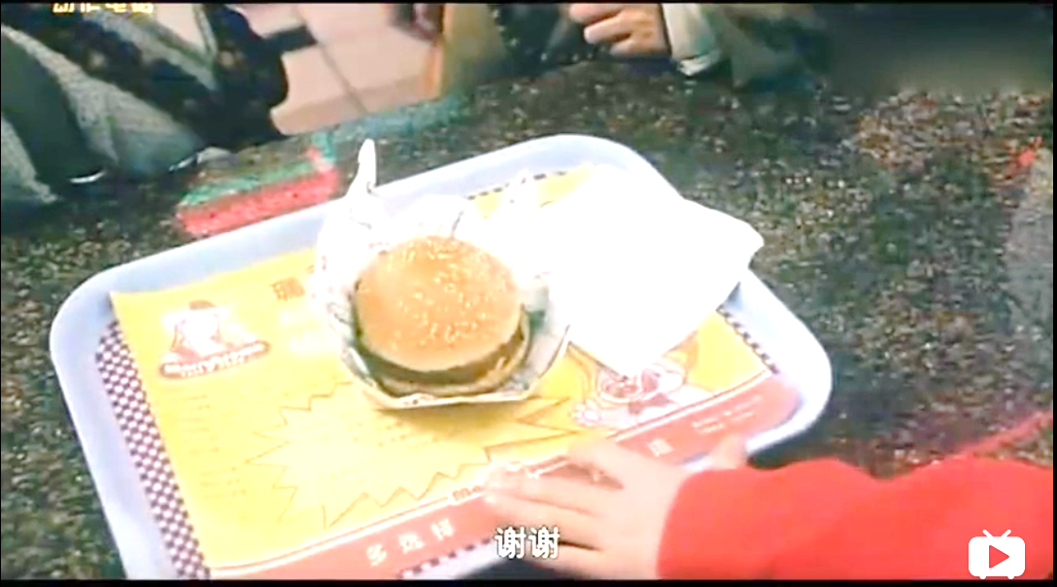
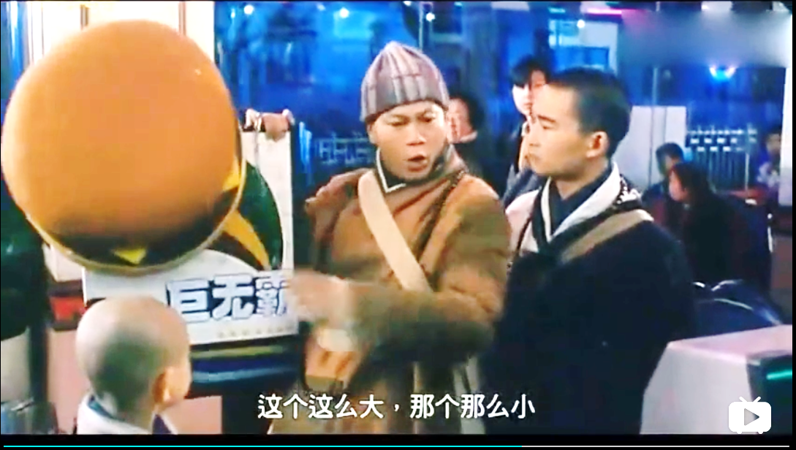
Marketing Data
Marketing data:
Impressive
Exaggerative
Deceptive
Massive
Truth for:
Rational purchasing
Intelligent product development
Computer vision:
Reveal the truth
Big Mac
This is so big, that is so small
https://www.bilibili.com/video/av23468710?from=search&seid=14946528699051298221
Notes:
Marketing data are impressive, while exaggerative and deceptive. Today, they are often massive. The truth behind the ads are important to both customers and competitors. In this proposal, I’d like to use video content analytics to reveal the truth behind the data

Slide 3

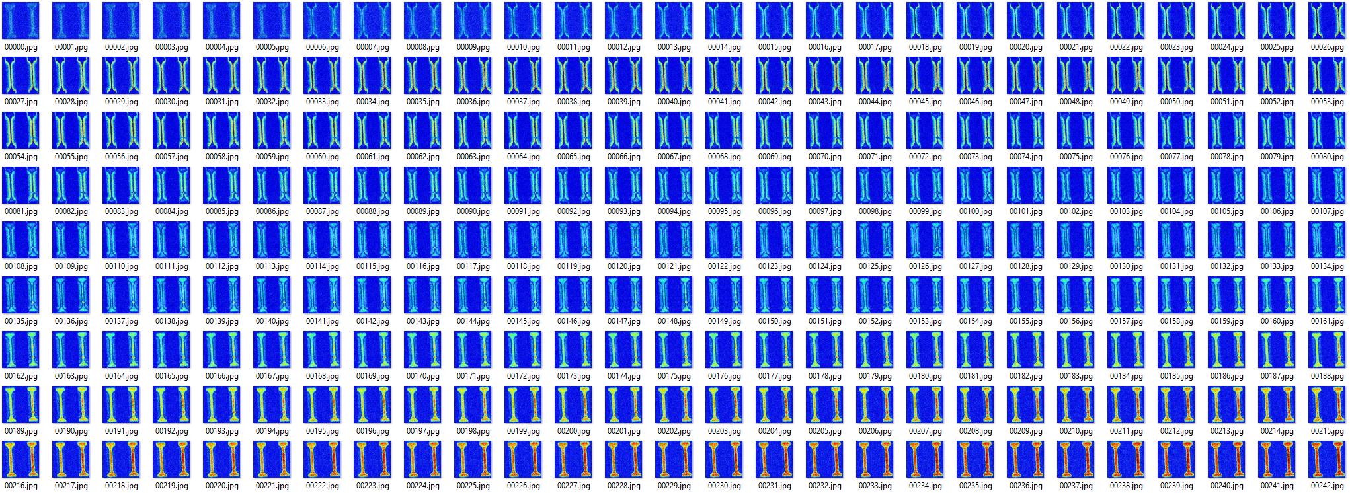
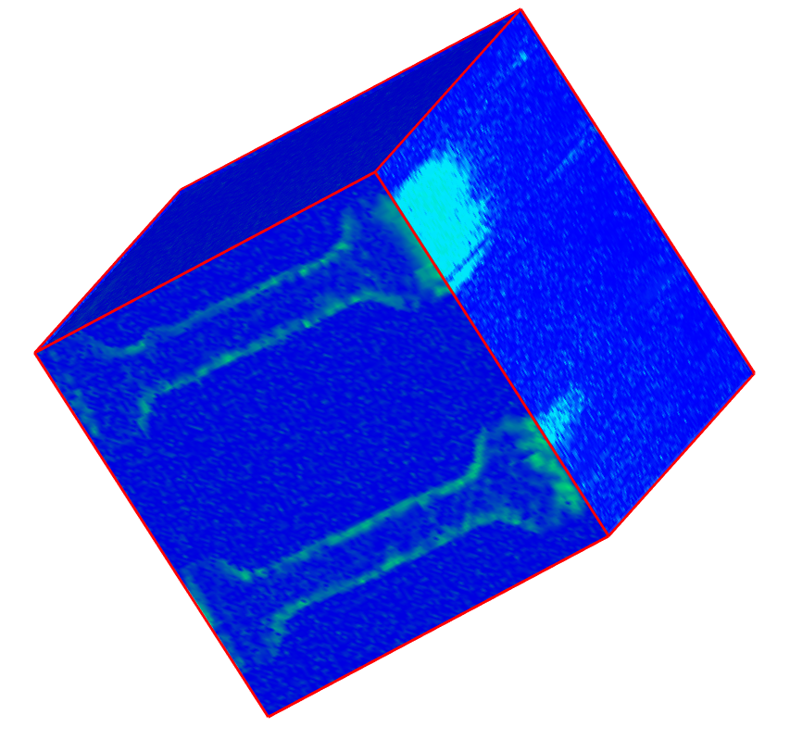
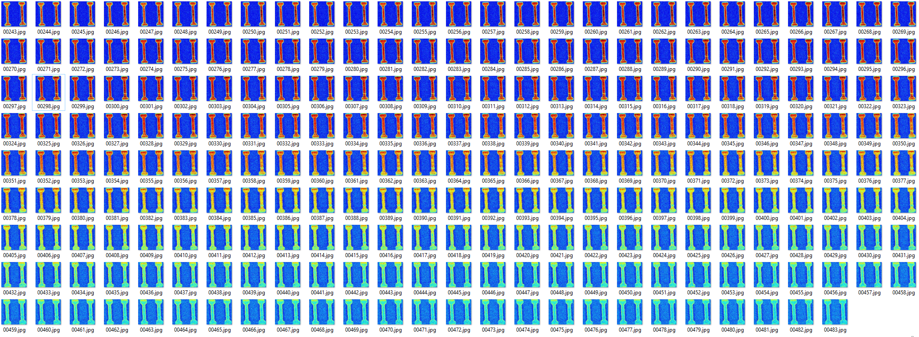
Data Extraction and Transformation
Performance of two devices on the same chip
From a video to a collection of frames, to a data cube
Marketing Video (18 s, 2.5 MB)
512 Extracted Frames, 7.1 MB
Data Cube: 128 x 128 x 484, 61 MB
3 µm x 3 µm
Movie.
Play it!
https://vimeo.com/255474034
Generally, > 100s of MB and messy
Removed 28 tailing frames
Easily get to GB level after interpolation
Notes:
This video promotes a technique that observes the dynamic performance of two devices on the same chip. The left one is normal, while the right is defective. Over 500 frames were extracted and transformed into a data cube. For proof-of-concept, a small video is used and a 61 MB data cube is generated. But, practically, high definition marketing videos can be at the GB level.

Slide 4
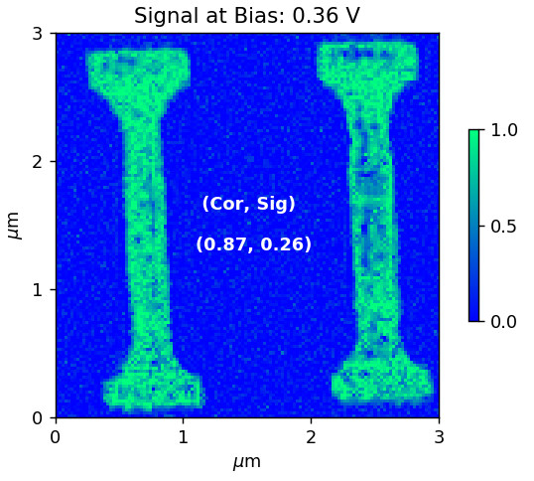
Data Mining: Correlation
Object detection and feature correlation for failure analysis
Normal
Notes:
First, object detection and feature correlation were used to isolate and correlate the two devices quantitatively. If the correlation is below 0.9, it indicates failure kicks in.

Slide 5
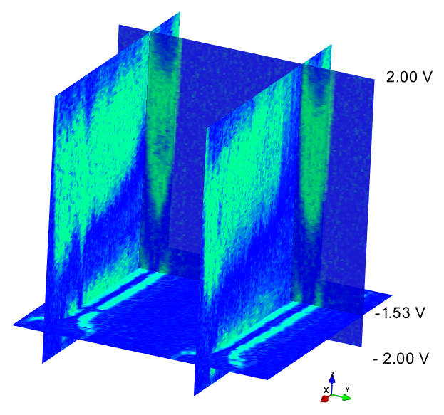
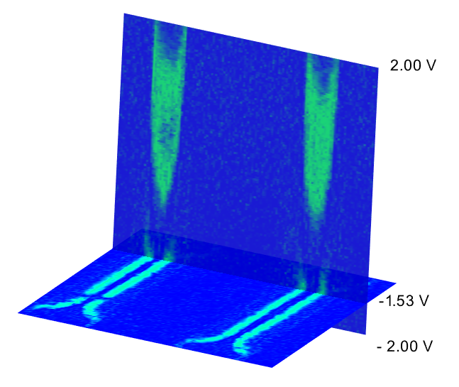
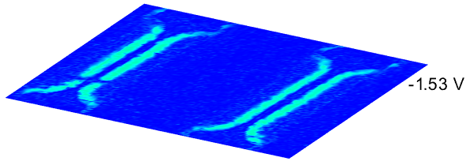
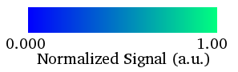
Data Mining: Depth Analysis
Data depth profiling along any angle
Spatial segmentation
defect
Bias
defect
defect
Notes:
Second, the cube structure not only shows the dynamic evolution of the major failure, but also shows details from other small ones. This visualization along any angle is extremely more informative than the original video.

Slide 6
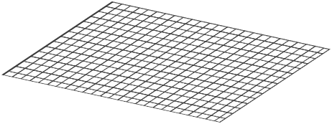
Data Mining: Spectral Analysis
Each pixel contains a spectrum
Spectrum per Pixel
Notes:
Third, from the cube, every pixel has a spectrum.

Slide 7
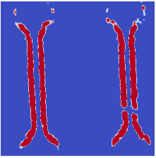
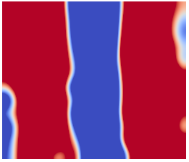
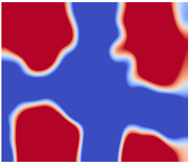
Data Mining: Spectral Analysis
Statistical representation:
Density plot
Normal
Defective
Notes:
This allows statistical representation by plotting together a collection of spectra from the region of interest, such as, this critical region

Slide 8
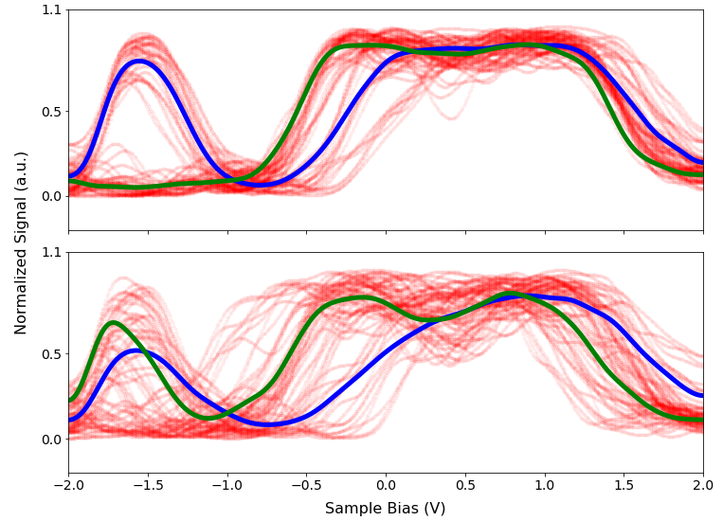
Data Mining: Spectral Analysis
64 Point Spectra from the Same Region
Density plot:
Clustering
Classification
Normal
Defective
Notes:
The two devices at this region have distinct patterns of density plots. The normal one has two clear clusters, while the defective one does not. The two clusters here also provide possible future classification of spectra from other regions for failure analysis at the pixel level.

Slide 9
Summary
Develop tools to see the insights of marketing data
Video content analytics: applies machine learning strategies to
reveal the truth behind ads
help customers for rational purchasing
help competitors to adjust product strategies
Notes:
In summary, this project will develop tools to see the insights of marketing data. It will apply machine learning to find out the truth behind ads for both customers and competitors.

